Slide 1

Faster R-CNN Real-Time Object Detection with Region Proposal Networks
$1^{st}$ Paper Study | 2022.07.06 Wed.
홍 세 현 Hong Sehyun

Slide 2
Outline
Outline
Introduction
Faster R-CNN
Experiments & Result
Reference
Q & A

Slide 3
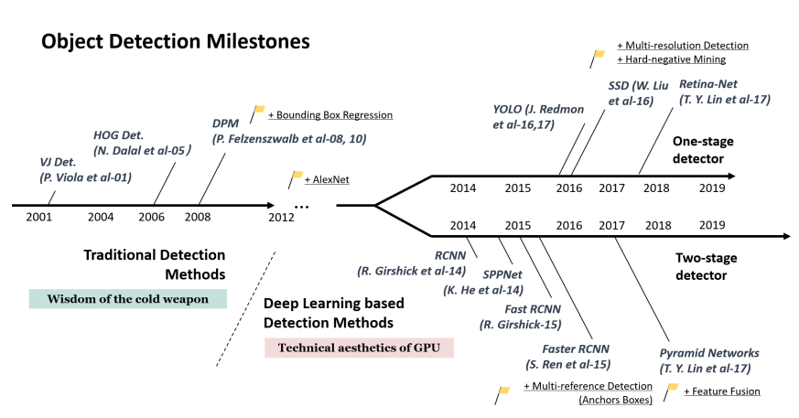
Outline
Introduction

Slide 4
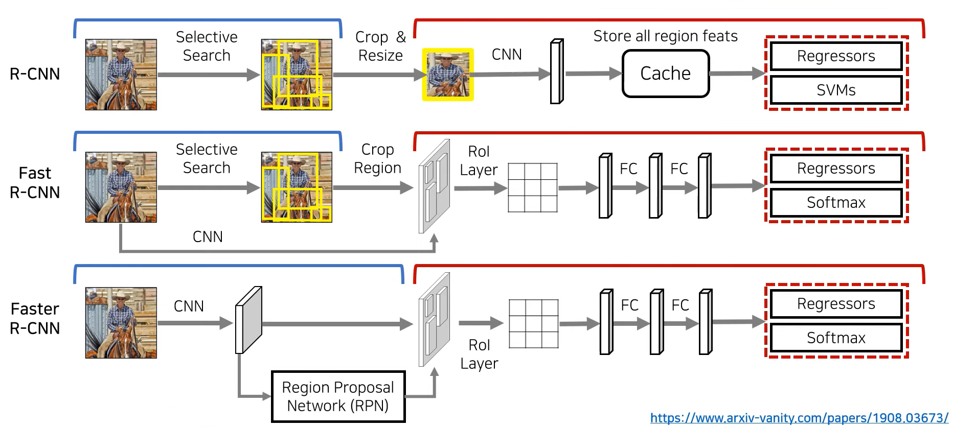
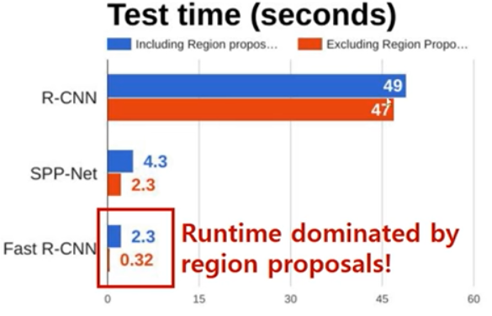
Outline
Introduction
Region Proposal
Classification
Disadvantages of Existing Models

Slide 5
Outline
Faster R-CNN
Region Proposal
Classification

Slide 6
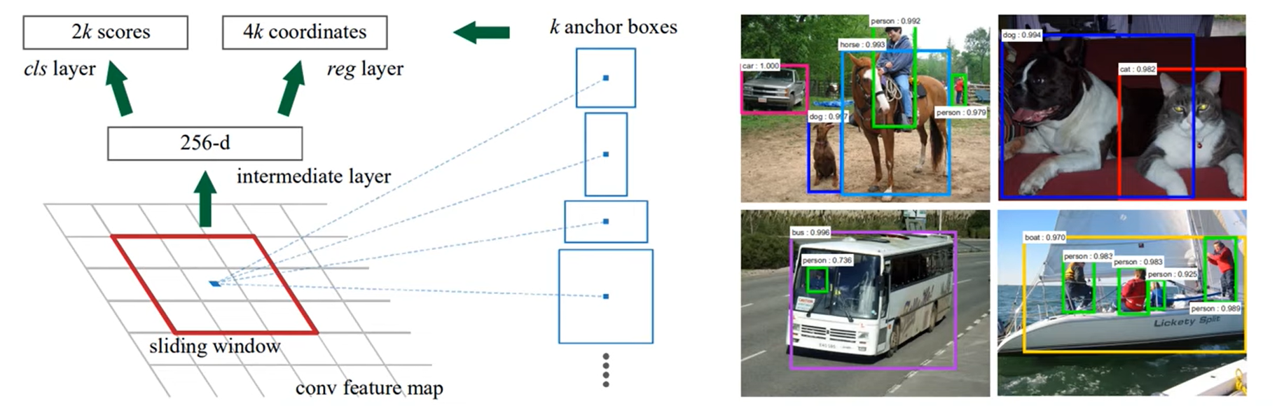
Outline
Faster R-CNN
Classify
Obj. / NOT-obj.
Regression
Tuning Box Locations
Regression gives offsets from anchor boxes
Using k anchor Boxes at each Location
3 scale (128x128, 256x256, 512x512)
3 ratio (2:1, 1:1, 1:2)

Slide 7
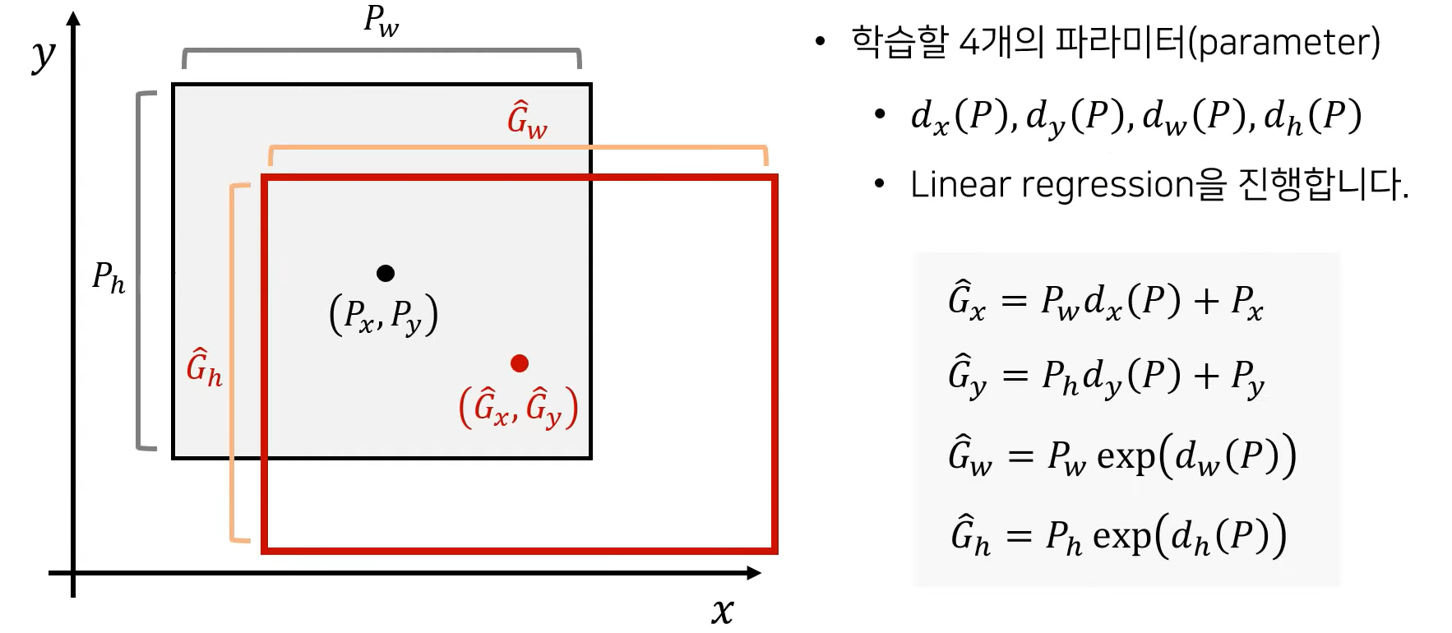
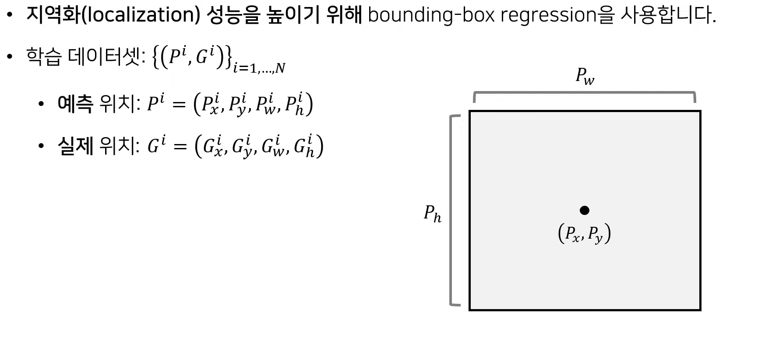
Outline
Faster R-CNN
Bounding Box Linear Regression
Learning Dataset
Predicted Location
Label Location

Slide 8
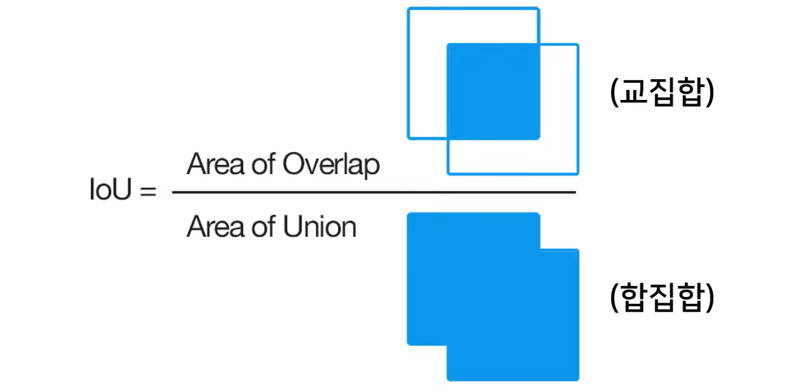
Outline
Faster R-CNN
Intersection Over Union(IoU) = 두 Bounding Box가 겹치는 비율
성능 평가 : mAP@0.5는 정답과 예측의 IoU가 50% 이상일 때 정답으로 판정하겠다는 의미
If, IoU > 0.7 : 1(Positive)
If, IoU < 0.3 : -1(Negative)
If, 0.3 <= IoU <= 0.7 : 0(Background, Ignore)

Slide 9
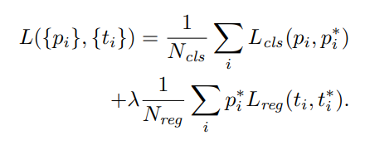
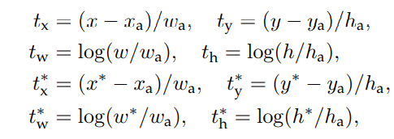
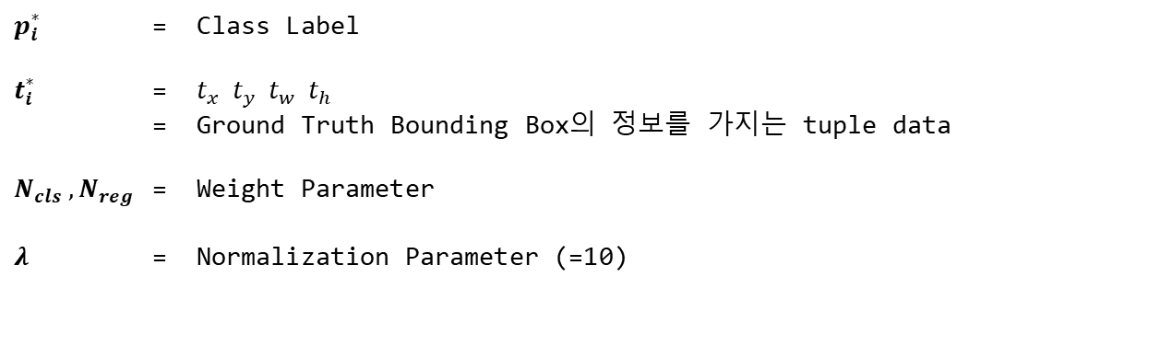
Outline
Faster R-CNN
Intersection Over Union(IoU) = 두 Bounding Box가 겹치는 비율
Loss Function
$p_{i}^{∗}$ = Class Label
$t_{i}^{∗}$ = $t_{x} t_{y} t_{w} t_{h}$
= Ground Truth Bounding Box의 정보를 가지는 tuple data
$N_{cls} , N_{reg}$ = Weight Parameter
$λ$ = Normalization Parameter (=10)

Slide 10
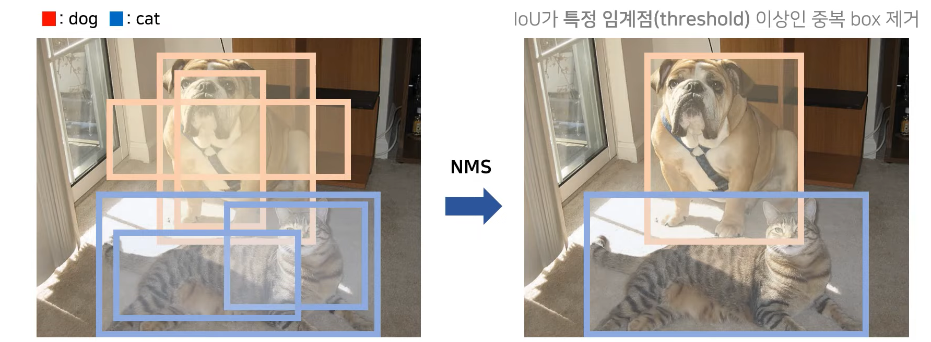
Outline
Faster R-CNN
Intersection Over Union(IoU) = 두 Bounding Box가 겹치는 비율
NMS 계산 : 같은 클래스(Class)끼리 IoU가 Threshold Value보다 이상일 때, 낮은 Confidence의 Bounding Box를 제거하는 방식 → 여러 개의 Bounding Box가 겹쳐 있는 경우에 하나로 합치는 방법!
(Non-Maximum Suppression)

Slide 11
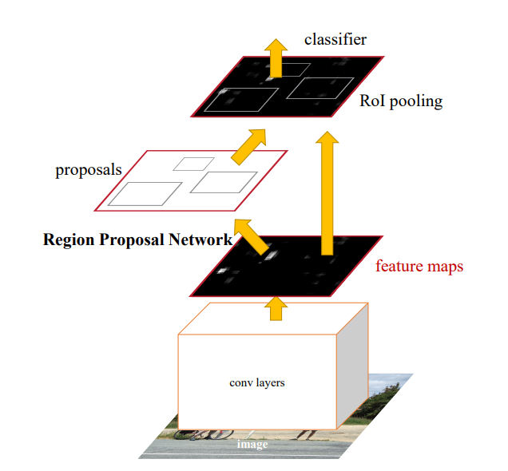
Outline
Faster R-CNN

Slide 12
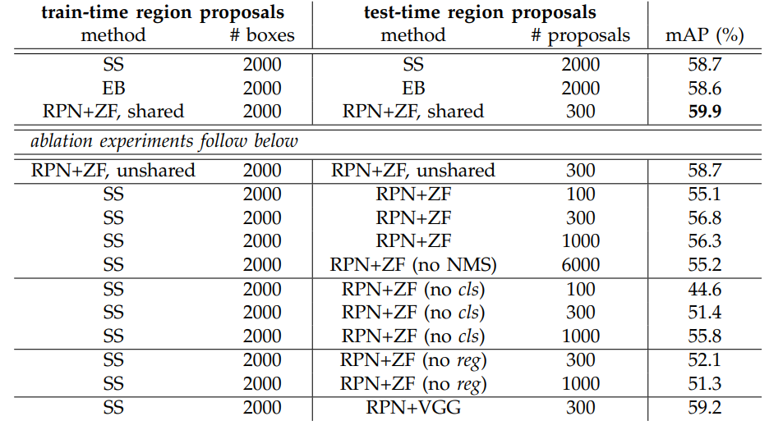
Outline
Experiments & Result

Slide 13
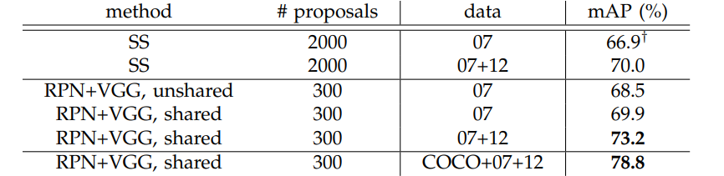
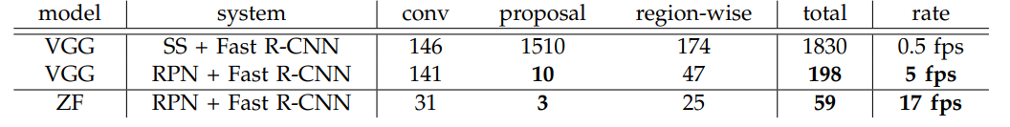
Outline
Experiments & Result

Slide 14
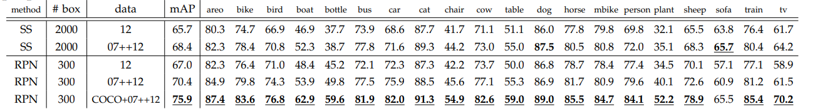
Outline
Experiments & Result

Slide 15
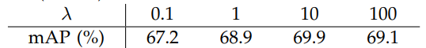
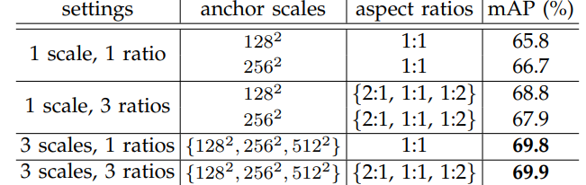
Outline
Experiments & Result

Slide 16
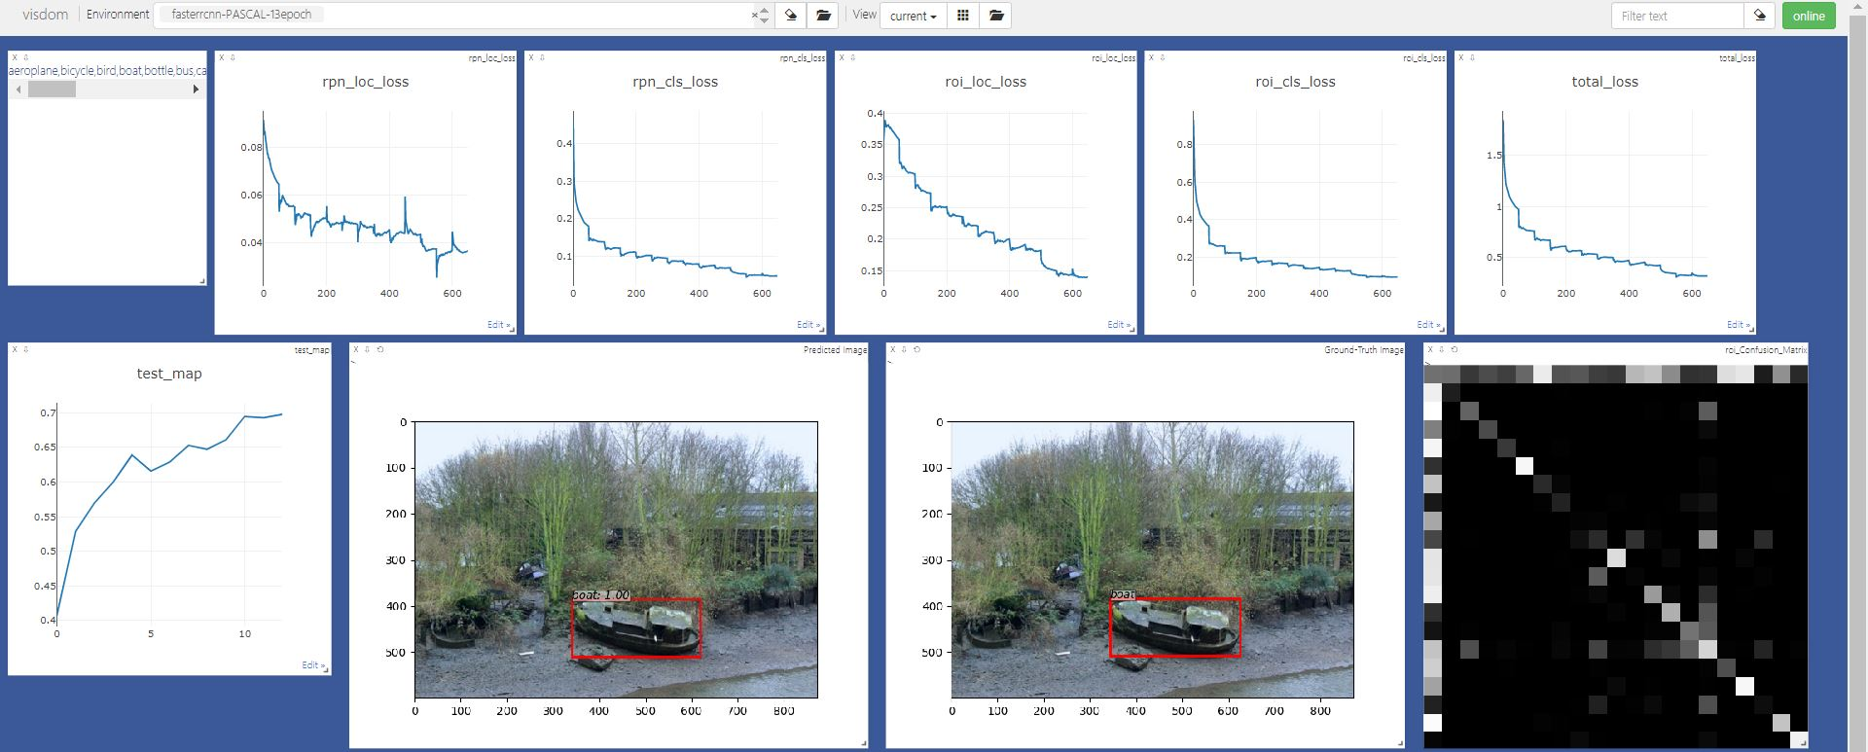
Outline
Experiments & Result

Slide 17
Outline
References
[Paper]
Ren, S., He, K., Girshick, R., & Sun, J. (2015). Faster r-cnn: Towards real-time object detection with region proposal networks. Advances in neural information processing systems, 28.
[Lecture]
https://www.youtube.com/watch?v=46SjJbUcO-c
https://www.youtube.com/watch?v=kcPAGIgBGRs&ab_channel=JinWonLee
https://www.youtube.com/watch?v=HmJWvwIpW5g&ab_channel=%EB%94%A5%EB%9F%AC%EB%8B%9D%EB%85%BC%EB%AC%B8%EC%9D%BD%EA%B8%B0%EB%AA%A8%EC%9E%84
[Blog]
https://blog.naver.com/kimsamuel351/222740515349
https://blog.naver.com/koreadeep/222661706323
https://foxtrotin.tistory.com/434

Slide 18
Q & A

Slide 19
Thank you 🙂

